Slide 1
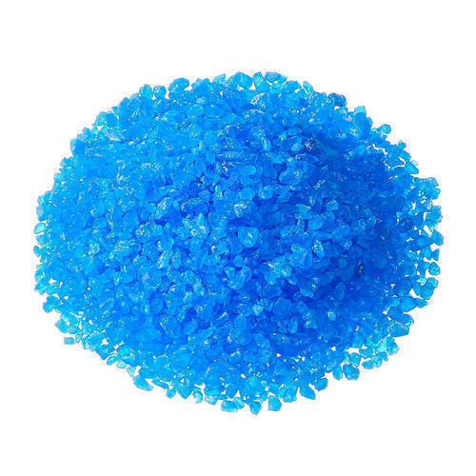
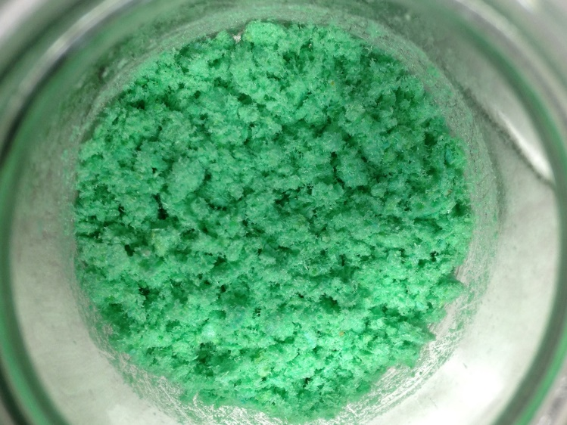
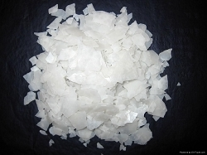
Daily Review
Salts
To a scientist, the term salt refers to any compound made from a metal and a non-metal (or group of non-metals).
Magnesium chloride (MgCl₂), copper chloride (CuCl₂), and copper sulfate (CuSO₄) are all salts.
Think, pair, share: Why are each of those substances classed as salts?

Slide 2
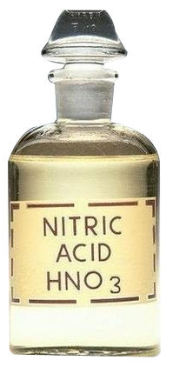
Daily Review
CFU 1
Which acid reacts with magnesium to form magnesium ethanoate?
Reaction of Acids with Metals
Salts are formed from the metal and the non-hydrogen part of the acid.
Different acids form different salts.
  Hydrochloric acid forms chloride salts, eg sodium chloride.
  Nitric acid forms nitrate salts, eg sodium nitrate.
  Sulfuric acid forms sulfate salts, eg sodium sulfate.
  Ethanoic acid (vinegar) forms ethanoate salts, eg sodium ethanoate.
CFU 2
What is the name of the salt formed when calcium reacts with sulfuric acid?
CFU 3
What are the reactants that would form aluminium chloride?

Slide 3
Skill Development / Guided Practice
Writing Word Equations for Acid-Metal Reactions
Identify the reactants in the reaction and write them first, with plus signs between each one.
Write an arrow at the end of the reactants, and put the hydrogen on the products side.
Identify the salt formed and add it to the products side.
What products are formed when zinc and nitric acid react together?
Reminder
Hydrochloric acid forms chloride salts Nitric acid forms nitrate salts Sulfuric acid forms sulfate salts Ethanoic acid (vinegar) forms ethanoate salts
Reactants
Zinc + Nitric acid
Products
Hydrogen +
→
Zinc nitrate

Slide 4
Skill Development / Guided Practice
Writing Word Equations for Acid-Metal Reactions
Identify the reactants in the reaction and write them first, with plus signs between each one.
Write an arrow at the end of the reactants, and put the hydrogen on the products side.
Identify the salt formed and add it to the products side.
Predict the products when iron reacts with hydrochloric acid.
Reminder
Hydrochloric acid forms chloride salts Nitric acid forms nitrate salts Sulfuric acid forms sulfate salts Ethanoic acid (vinegar) forms ethanoate salts
Reactants
Iron + Hydrochloric acid
Products
Hydrogen +
→
Iron chloride

Slide 5
Reaction of Acids
With Bases
Year 9 Science

Slide 6
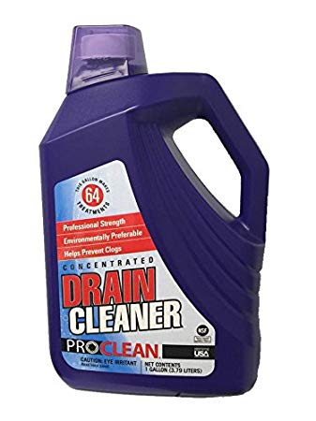
Learning Objectives
CFU
What are we learning about?
Predict products of reactions between acids and hydroxide bases
Predict products of reactions between acids and carbonate bases
Activate Prior Knowledge
Drain cleaner contains sodium hydroxide (NaOH), which is a strong base. If some gets on your skin, it can cause burns because it is corrosive.
Think, pair share: What are two household products that could be used to reduce the effects of the drain cleaner.

Slide 7
Concept Development
CFU 1
What is a group of non-metals found in bases?
Hydroxide Bases
Many bases contain a group of non-metal atoms called a hydroxide.
A hydroxide made from an oxygen atom and a hydrogen atom joined together (OH).
Some examples of hydroxide bases are:
  Sodium hydroxide, NaOH – used in drain cleaner
  Calcium hydroxide, Ca(OH)₂ – used in paper production
  Magnesium hydroxide, Mg(OH)₂ – used in antacids
CFU 2
Which two elements make up a hydroxide?

Slide 8
Concept Development
CFU 1
What is a group of non-metals found in bases?
Carbonate Bases
Many bases contain a group of non-metal atoms called a carbonate.
A carbonate is made from three oxygen atoms and a carbon atom joined together (CO₃).
Some examples of carbonate bases are:
  Magnesium carbonate MgCO₃ – used in antacids
  Calcium carbonate, CaCO₃ – found in limestone
CFU 2
Which two elements make up a carbonate?

Slide 9
Concept Development
CFU 1
Where does the water produced come from?
Reaction of Acids with Bases
When an acid reacts with either type of base, water and a salt is produced.
The water is formed from the hydrogen in the acid reacting with oxygen from the base.
The other part of the acid reacts with the metal from the base to form a salt.
Carbonate bases also produce carbon dioxide from the carbon and oxygen in the carbonate.
CFU 2
How is the salt formed?
CFU 3
What additional product is formed from a base containing carbonate?

Slide 10
Concept Development
CFU 1
What products form when zinc hydroxide and hydrochloric acid react?
Reaction of Acids with Hydroxide Bases
For example:
Sodium hydroxide + hydrochloric acid → water + sodium chloride
NaOH + HCl → H₂O + NaCl
Water forms from hydrogen in the acid and hydroxide from the base.
Sodium chloride forms from the metal in the hydroxide and the chlorine in the acid.
This type of reaction is called neutralisation, because water is formed which is a neutral substance.
CFU 2
Why are these reactions referred to as neutralisation?

Slide 11

Concept Development
Testing for Neutralisation
When an acid and a hydroxide base react, they form water and a salt.
Both the water and the salt are neutral substances.
Universal indicator can be used to show the pH of the reaction.
When the acid and hydroxide base are neutralised, the universal indicator will be green.

Slide 12
Concept Development
CFU 1
What products form when zinc carbonate and hydrochloric acid react?
Reaction of Acids with Carbonate Bases
For example:
Sodium carbonate + hydrochloric acid → water + carbon dioxide + sodium chloride
2NaCO₃ + 2HCl → H₂O + 2CO₂ + 2NaCl
Carbon dioxide comes from the carbonate.
Water forms from the hydrogen in the acid and an oxygen from the carbonate in the base.
The sodium chloride has formed from the metal in the carbonate and the chlorine in the acid.

Slide 13
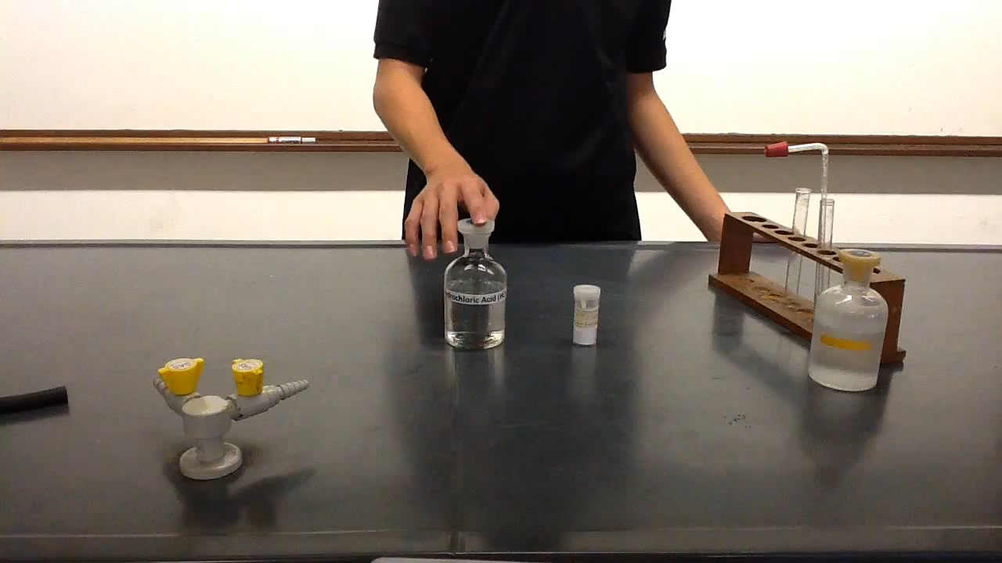
Concept Development
CFU 1
How do you test for the presence of carbon dioxide?
Testing for Carbon Dioxide
When an acid and a carbonate base react, they form water, carbon dioxide and a salt.
We can test for carbon dioxide using a substance called limewater.
The gas produced is bubbled through limewater, which turns cloudy if carbon dioxide is present.
CFU 2
What will you observe if carbon dioxide is present?

Slide 14
Skill Development / Guided Practice
Reminder
Hydrochloric acid forms chloride salts Nitric acid forms nitrate salts Sulfuric acid forms sulfate salts Ethanoic acid (vinegar) forms ethanoate salts
Writing Word Equations for Acid-Base Reactions
Write the reactants first, followed by an arrow.
Write the water on the products side.
Identify the salt formed and add it to the products side.
Add carbon dioxide to the products side for carbonate reactions.
Predict the products when zinc hydroxide reacts with hydrochloric acid.
Reactants
Zinc hydroxide + Hydrochloric acid
Products
Water +
→
Zinc chloride

Slide 15
Skill Development / Guided Practice
Reminder
Hydrochloric acid forms chloride salts Nitric acid forms nitrate salts Sulfuric acid forms sulfate salts Ethanoic acid (vinegar) forms ethanoate salts
Writing Word Equations for Acid-Base Reactions
Write the reactants first, followed by an arrow.
Write the water on the products side.
Identify the salt formed and add it to the products side.
Add carbon dioxide to the products side for carbonate reactions.
Predict the products when copper hydroxide reacts with sulfuric acid.
Reactants
Copper hydroxide + Sulfuric acid
Products
Water +
→
Copper sulfate

Slide 16
Skill Development / Guided Practice
Reminder
Hydrochloric acid forms chloride salts Nitric acid forms nitrate salts Sulfuric acid forms sulfate salts Ethanoic acid (vinegar) forms ethanoate salts
Writing Word Equations for Acid-Base Reactions
Write the reactants first, followed by an arrow.
Write the water on the products side.
Identify the salt formed and add it to the products side.
Add carbon dioxide to the products side for carbonate reactions.
Predict the products when iron carbonate reacts with hydrochloric acid.
Reactants
Iron carbonate + Hydrochloric acid
Products
Water + Carbon dioxide +
→
Iron chloride

Slide 17
Skill Development / Guided Practice
Reminder
Hydrochloric acid forms chloride salts Nitric acid forms nitrate salts Sulfuric acid forms sulfate salts Ethanoic acid (vinegar) forms ethanoate salts
Writing Word Equations for Acid-Base Reactions
Write the reactants first, followed by an arrow.
Write the water on the products side.
Identify the salt formed and add it to the products side.
Add carbon dioxide to the products side for carbonate reactions.
Predict the products when zinc carbonate reacts with nitric acid.
Reactants
Zinc carbonate + Nitric acid
Products
Water + Carbon dioxide +
→
Zinc nitrate

Slide 18
Skill Development / Guided Practice
Reminder
Hydrochloric acid forms chloride salts Nitric acid forms nitrate salts Sulfuric acid forms sulfate salts Ethanoic acid (vinegar) forms ethanoate salts
Writing Word Equations for Acid-Base Reactions
Write the reactants first, followed by an arrow.
Write the water on the products side.
Identify the salt formed and add it to the products side.
Add carbon dioxide to the products side for carbonate reactions.
Predict the products when sodium hydroxide reacts with ethanoic acid.
Reactants
Sodium hydroxide + Ethanoic acid
Products
Water +
→
Sodium ethanoate

Slide 19
Skill Development / Guided Practice
Reminder
Hydrochloric acid forms chloride salts Nitric acid forms nitrate salts Sulfuric acid forms sulfate salts Ethanoic acid (vinegar) forms ethanoate salts
Writing Word Equations for Acid-Base Reactions
Write the reactants first, followed by an arrow.
Write the water on the products side.
Identify the salt formed and add it to the products side.
Add carbon dioxide to the products side for carbonate reactions.
Predict the products when copper carbonate reacts with sulfuric acid.
Reactants
Copper carbonate + Sulfuric acid
Products
Water + Carbon dioxide +
→
Copper sulfate

Slide 20
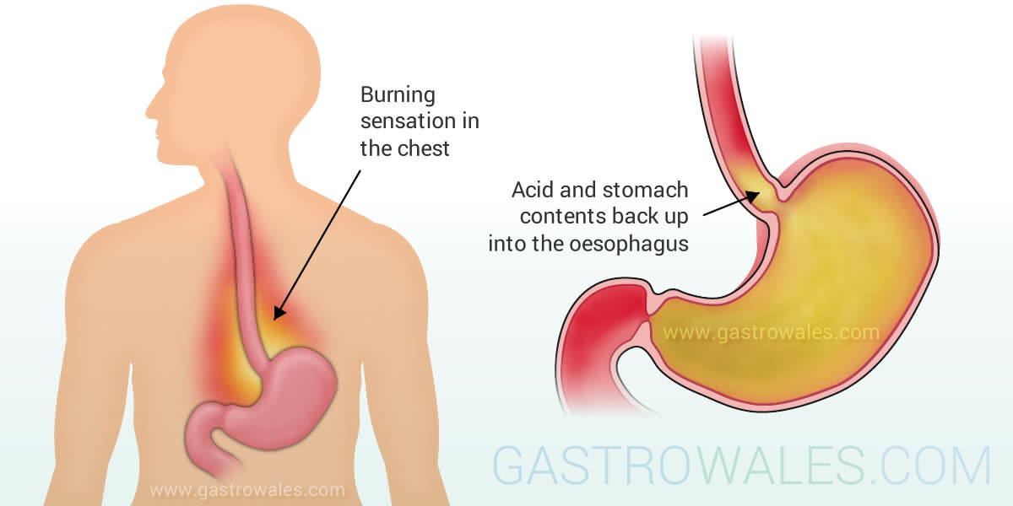


Relevance
Knowing how acids react with different substances will help you understand how and why acids are used for different purposes.
The reaction between bases and acids can be used to neutralise the burning sensation you feel when indigestion causes stomach acid to rise up your throat.
Sherbet is a mixture of a weak acid and weak base. When they dissolve in your mouth, the reaction between them creates the fizzing feeling as carbon dioxide is produced.
Coral in reefs is composed of calcium carbonate. Increased air pollution has caused the oceans to become acidic. The acidity of the oceans is causing damage to the calcium carbonate that forms the reefs.

Slide 21
Skill Closure
Why are reactions between acids and bases also known as neutralisation?
Skill Closure
Explain how to test whether the gas produced is carbon dioxide.
Skill Closure
Predict the products of the reaction between hydrochloric acid and zinc carbonate, and write a word equation.

Slide 22
Independent Practice
Complete the worksheet “Reactions of Acids Word Equations” on a paper copy or on Connect.

